Slide 1
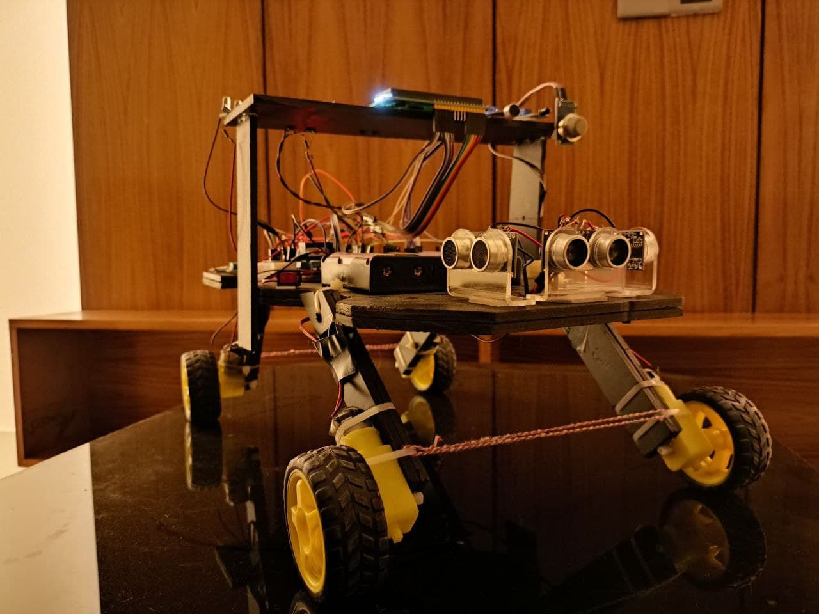
3S-Bot
A project By
Team Tri-Ancestillians

Slide 2
Team Tri Ancestillians
180204054 Arman Sakif
180204073 Rahat Ashik
180204074 Sadman Alvee
170104001 Minhajul Jim

Slide 3
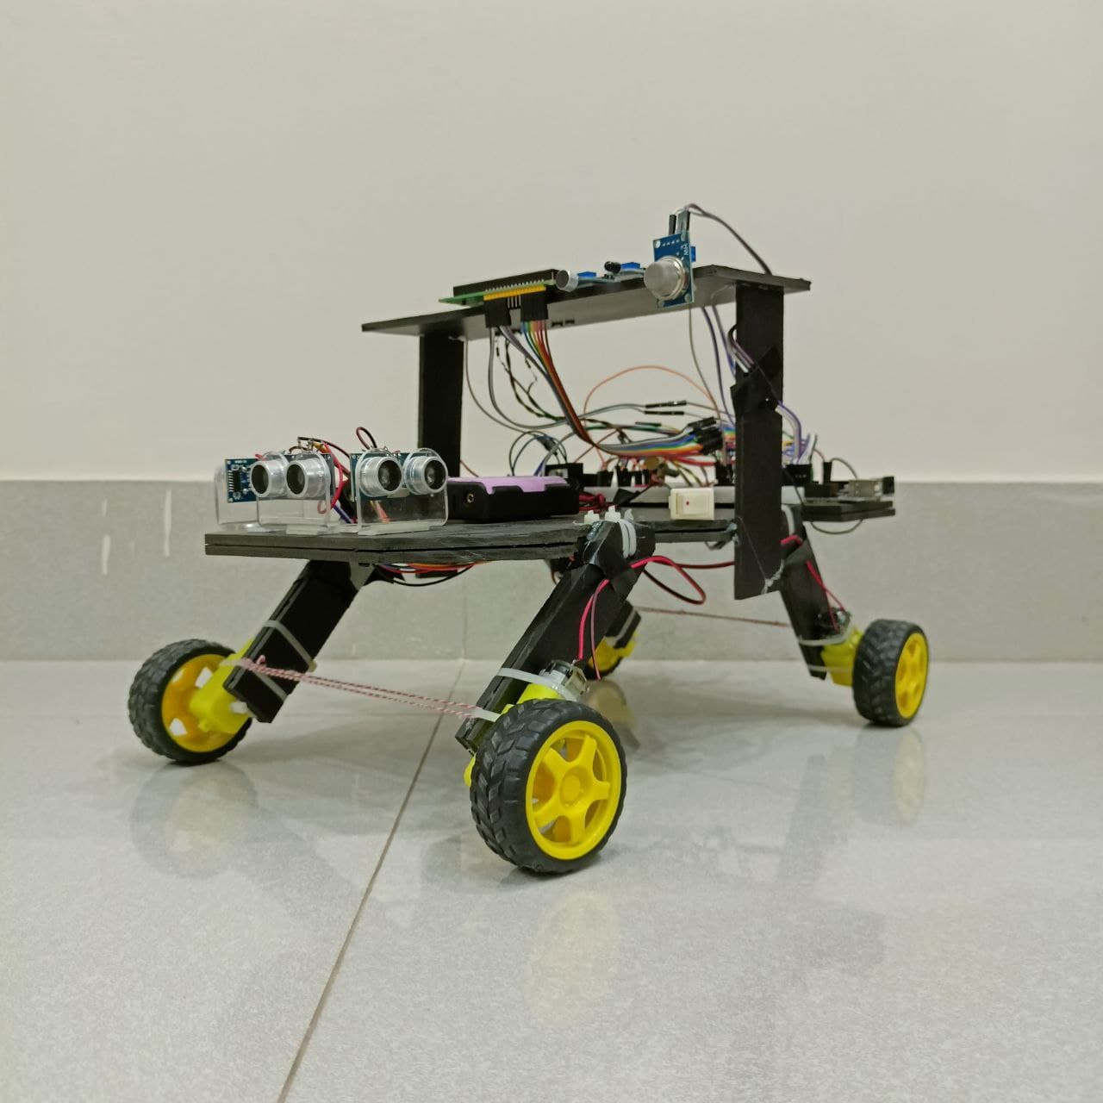
Objectives
Security
Surveillance
Service

Slide 4
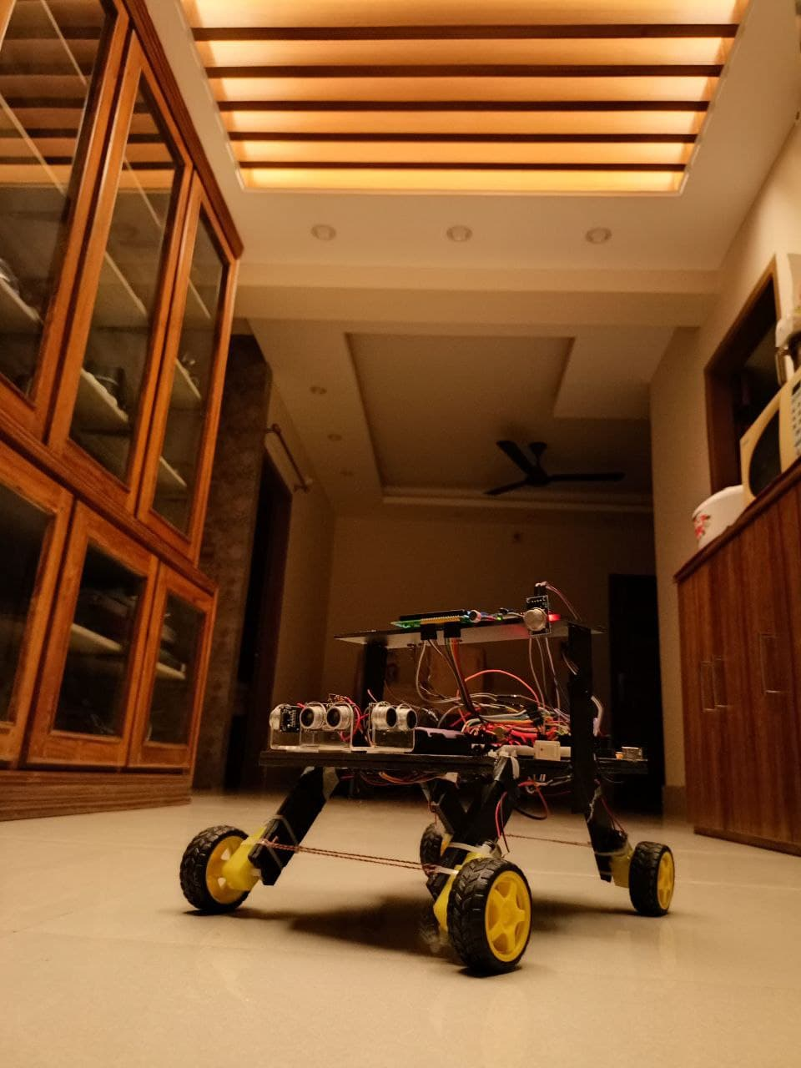
Social Values
Exploration/Research
Defence
Safety from criminal Activity
Help in Daily life
Camera man

Slide 5
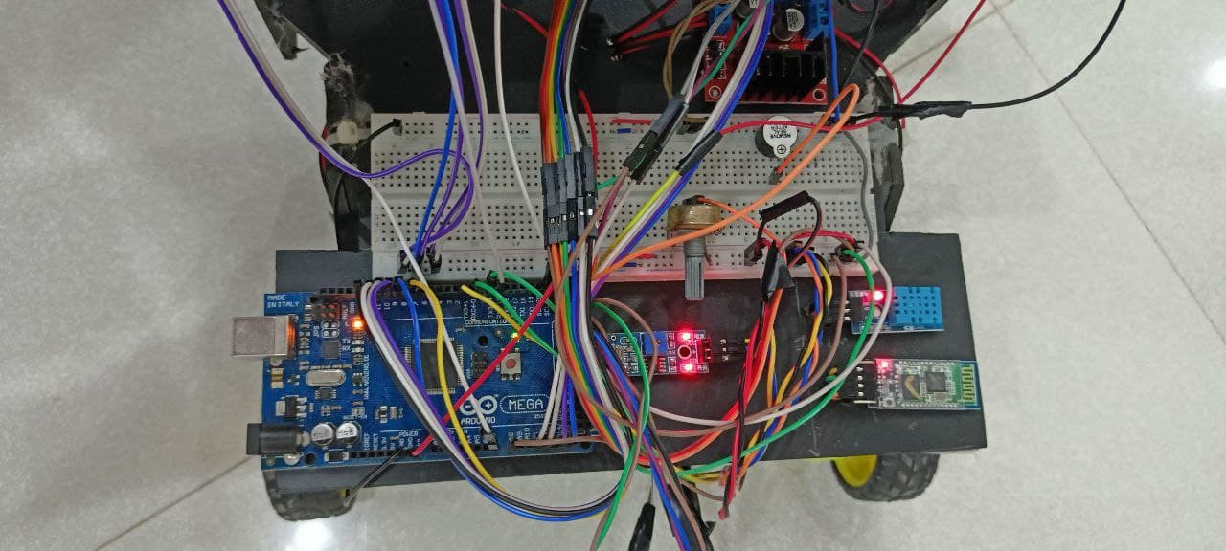
Required Components
Microcontroller unit: Arduino
Shield: L298 motor shield
Sensors: flame, gas, LDR, temp, humidity etc.
Modules: Bluetooth HC05, camera, LCD
Motors: DC, Servo
Tools
Other Basic Components

Slide 6
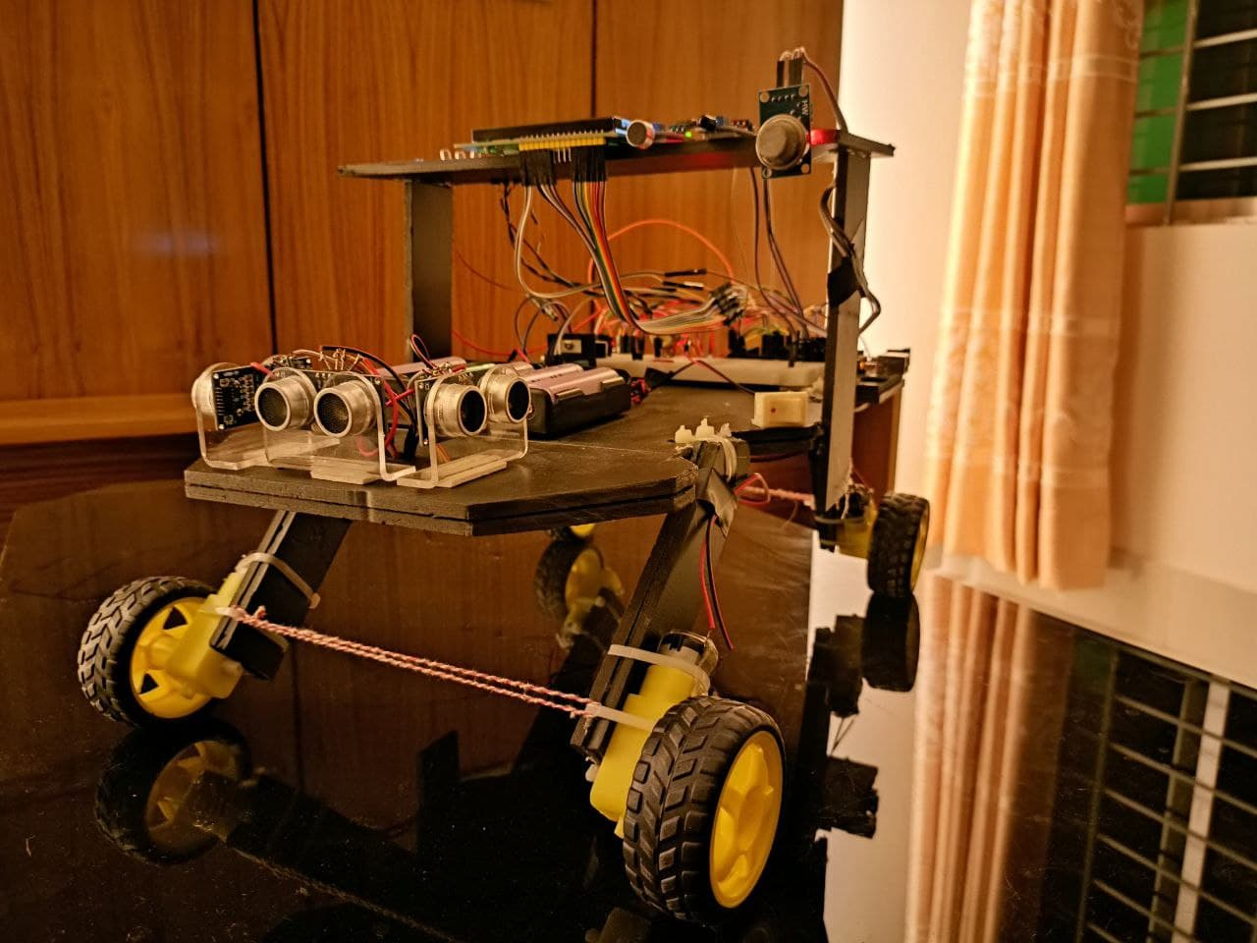
Working Procedure: Inputs
Sensors
Camera
Modules

Slide 7
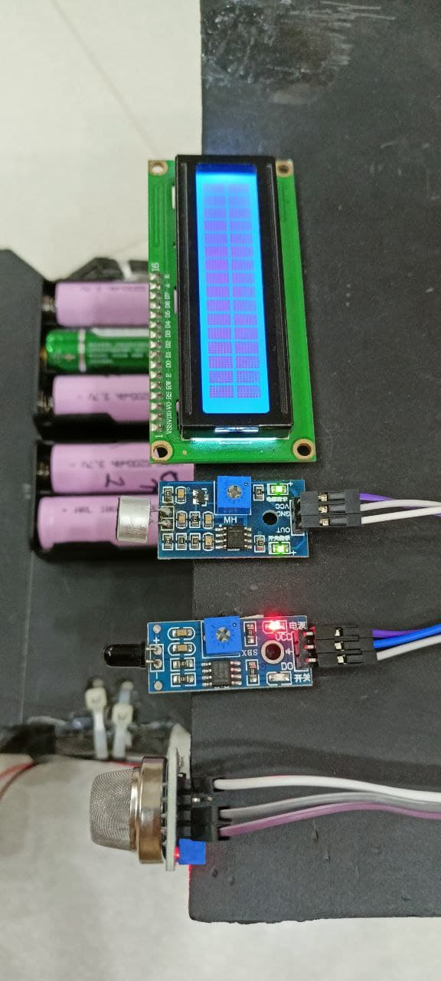
Working Procedure: Outputs
LCD Display
LED Lights
Buzzer

Slide 8
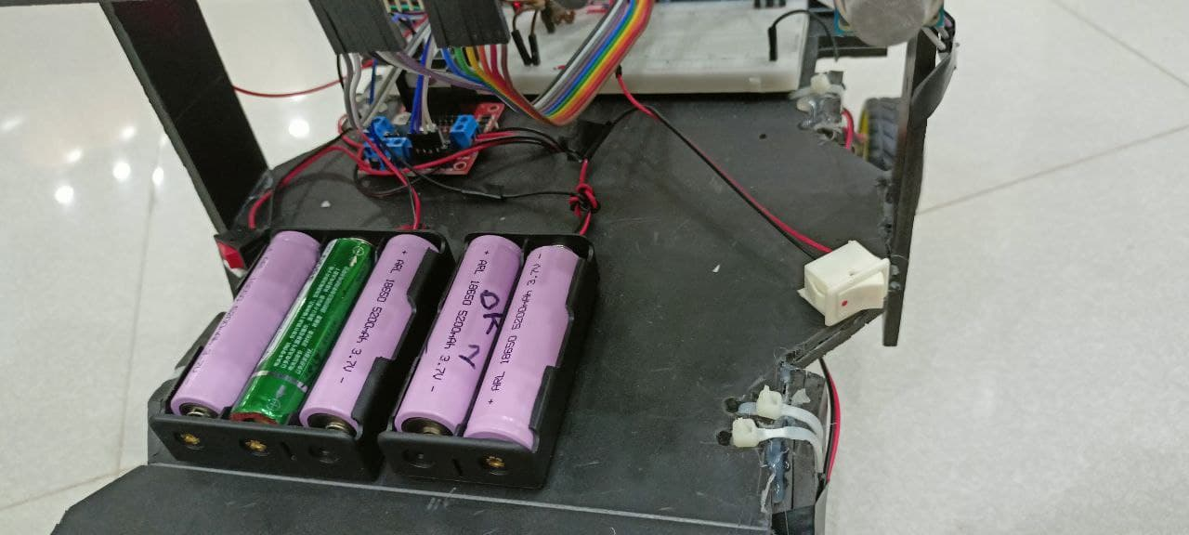
Working Procedure: Power Supply
Numerous Li-ion Batteries

Slide 9
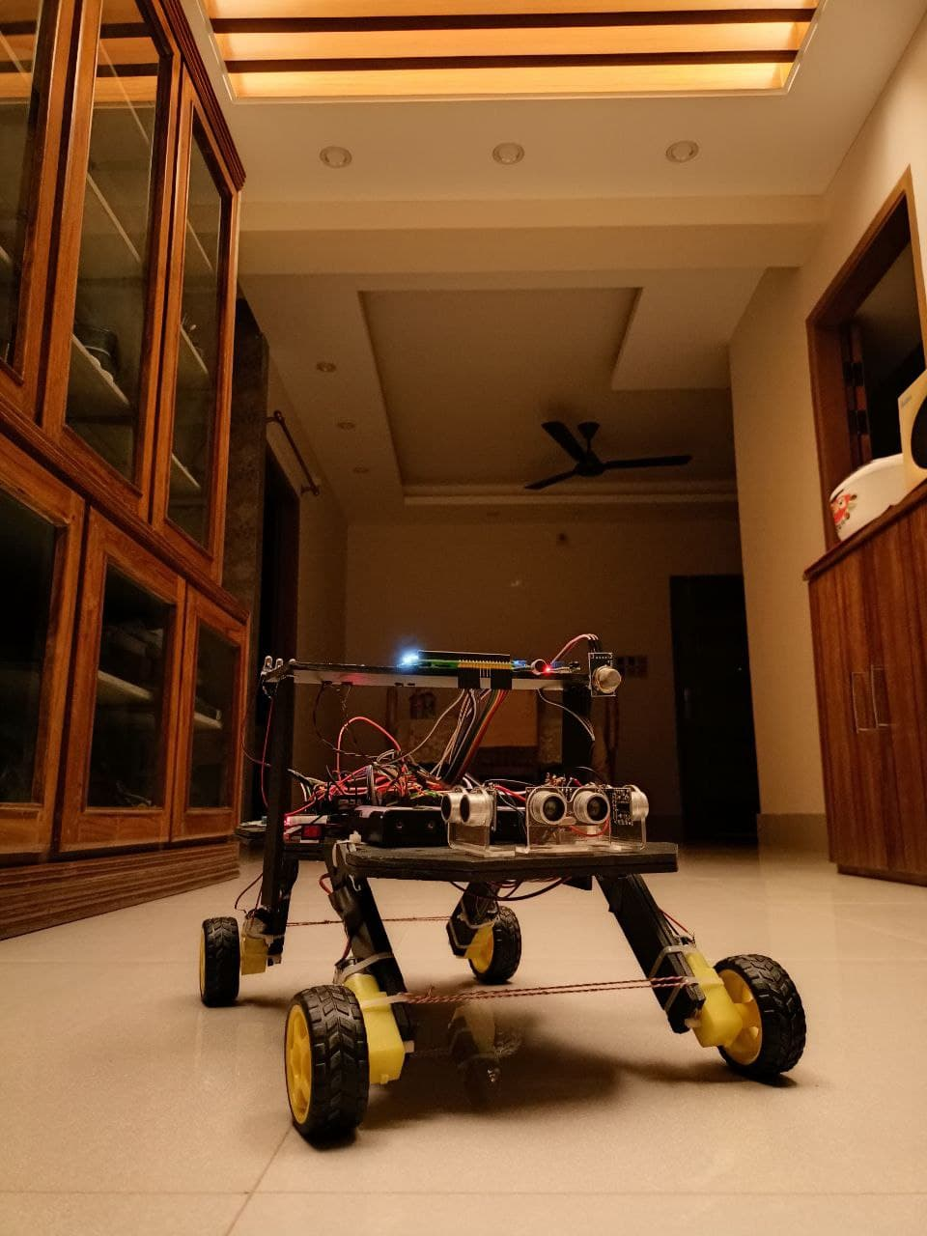
Budget Comparison
Estimated Budget 9557/-
Final Expenditure 10151/-

Slide 10
Contribution of Team Members
Alvee collected all the materials, worked on LDR, LCD, temp-humidity, bot design
Arman worked on sound and flame sensor, LED lights for alarm, gas sensor circuit
Jim worked on motor connection and driver, voltage source switches, Bth module
Rahat worked on US sensor, buzzer, power supply and gas sensor code

Slide 11
Challenges of The Project
Expensive
Online Classes due to Omicron
Some components burnt
Codes mismatch thus the camera doesn't work.
Live feedback app from web didn't work while testing.

Slide 12
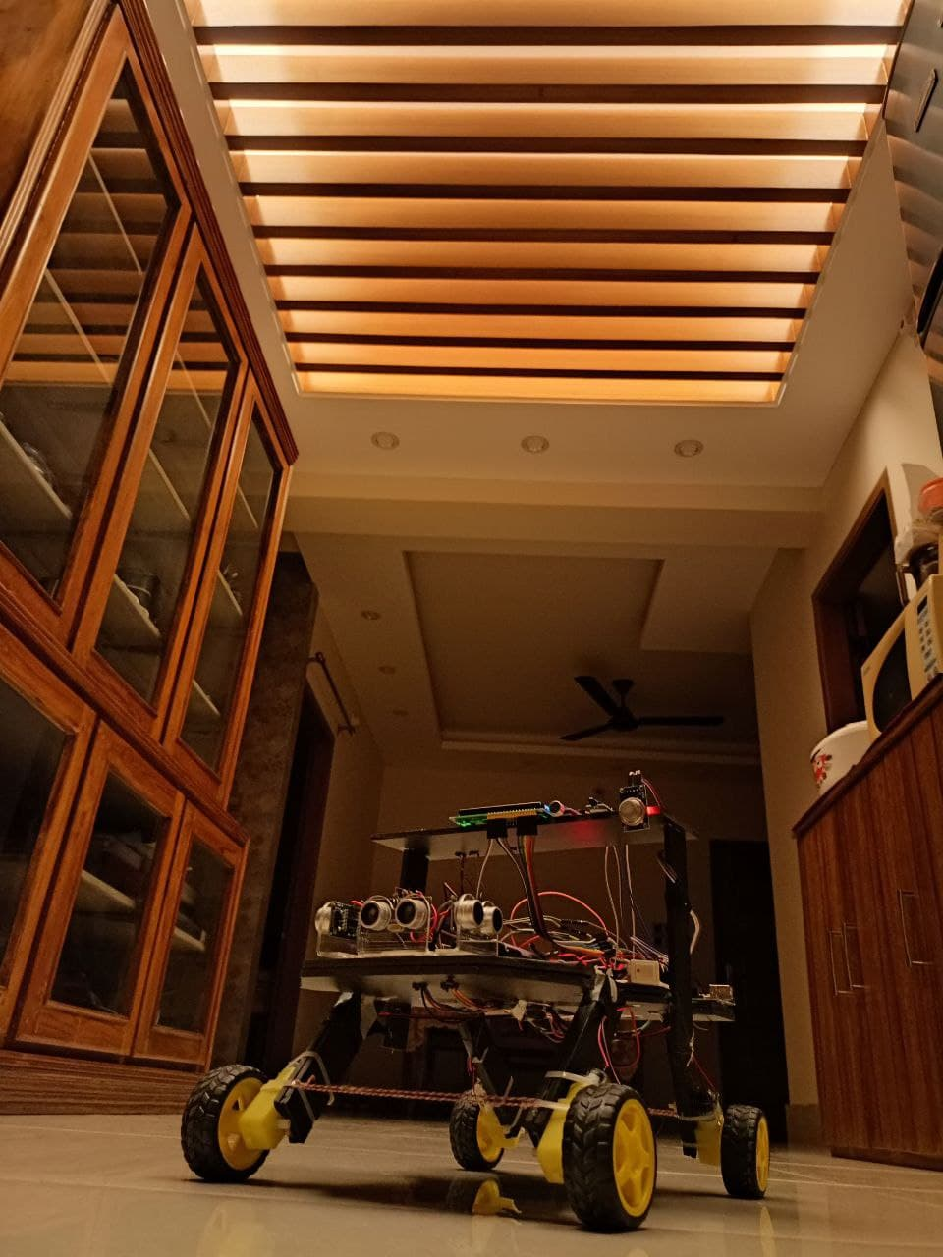
Conclusion
We could not add the camera due to technical difficulties.
More Expensive than others projects.
Ended up as an aesthetic looking robot.
Sophisticated coding makes bot movement crash free.
The current bot can help society in Security, Surveillance and daily life.

